Slide 1
Turing Machines (TM)
Generalize the class of CFLs:
Non-Recursively Enumerable Languages
Recursively Enumerable Languages
Recursive Languages
Context-Free Languages
Regular Languages

Slide 2
Types of Grammar:-
Recursively enumerable languages are also known as type 0 languages.
Context-sensitive languages are also known as type 1 languages.
Context-free languages are also known as type 2 languages.
Regular languages are also known as type 3 languages.

Slide 3
Deterministic Turing Machine (DTM)
…….. ……..
Two-way, infinite tape, broken into cells, each containing one symbol.
Two-way, read/write tape head.
An input string is placed on the tape, padded to the left and right infinitely with blanks, read/write head is positioned at the left end of input string.
Finite control, i.e., a program, containing the position of the read head, current symbol being scanned, and the current state.
In one move, depending on the current state and the current symbol being scanned, the TM 1) changes state, 2) prints a symbol over the cell being scanned, and 3) moves its’ tape head one cell left or right.
Many modifications possible, but Church-Turing declares equivalence of all.
B | B | 0 | 1 | 1 | 0 | 0 | B | B
Finite
Control

Slide 4
Formal Definition of a DTM
A DTM is a seven-tuple:
M = (Q, Σ, Γ, δ, q₀, B, F)
Q A finite set of states
Σ A finite input alphabet, which is a subset of Γ– {B}
Γ A finite tape alphabet, which is a strict superset of Σ
B A distinguished blank symbol, which is in Γ
q₀ The initial/starting state, q₀ is in Q
F A set of final/accepting states, which is a subset of Q
δ A next-move function, which is a mapping (i.e., may be undefined) from
Q x Γ –> Q x Γ x {L,R}
Intuitively, δ(q,s) specifies the next state, symbol to be written, and the direction of tape head movement by M after reading symbol s while in state q.

Slide 5
Example #1: {w | w is in {0,1}* and w ends with a 0}
0
00
10
10110
Not ε
Q = {q₀, q₁, q₂}
Γ = {0, 1, B}
Σ = {0, 1}
F = {q₂}
δ:
0 1 B
->q₀ (q₀, 0, R) (q₀, 1, R) (q₁, B, L)
q₁ (q₂, 0, R) - -
q₂* - - -
q₀ is the start state and the “scan right” state, until hits B
q₁ is the verify 0 state
q₂ is the final state

Slide 6
Making a TM for {0^{n}1^{n} | n >= 1}
Try n=2 or 3 first.
q0 is on 0, replaces with the character to X, changes state to q1, moves right
q1 sees next 0, ignores (both 0’s and X’s) and keeps moving right
q1 hits a 1, replaces it with Y, state to q2, moves left
q2 sees a Y or 0, ignores, continues left
when q2 sees X, moves right, returns to q0 for looping step 1 through 5
when finished, q0 sees Y (no more 0’s), changes to pre-final state q3
q3 scans over all Y’s to ensure there is no extra 1 at the end (to crash on seeing any 0 or 1)
when q3 sees B, all 0’s matched 1’s, done, changes to final state q4
blank line for final state q4
Try n=1 next.
Make sure unbalanced 0’s and 1’s, or mixture of 0-1’s,
“crashes” in a state not q4, as it should be
q₀0011BB.. |— Xq₁011
|— X0q₁11
|— Xq₂0Y1
|— q₂X0Y1
|— Xq₀0Y1
|— XXq₁Y1
|— XXYq₁1
|— XXq₂YY
|— Xq₂XYY
|— XXq₀YY
|— XXYq₃Y B…
|— XXYYq₃ BB…
|— XXYYBq₄

Slide 7
Modifications of the TM Model
Other (Extended) TM Models:
One-way infinite tapes
Multiple tapes and tape heads
Non-Deterministic TMs
Multi-Dimensional TMs (n-dimensional tape)
Multi-Heads
Multiple tracks
All of these extensions are equivalent to the basic DTM model

Slide 8
TM Block Diagrams:
If L is a recursive language, then a TM M that accepts L and always halts can be pictorially represented by a “chip” or “box” that has one input and two outputs.
If L is a recursively enumerable language, then a TM M that accepts L can be pictorially represented by a “box” that has one output.
Conceivably, M could be provided with an output for “no,” but this output cannot be counted on. Consequently, we simply ignore it.
yes
w
M
no
yes
w
M

Slide 9
The Halting Problem - Background
Definition: A decision problem is a problem having a yes/no answer (that one presumably wants to solve with a computer). Typically, there is a list of parameters on which the problem is based.
Given a list of numbers, is that list sorted?
Given a number x, is x even?
Given a C program, does that C program contain any syntax errors?
Given a TM (or C program), does that TM contain an infinite loop?
From a practical perspective, many decision problems do not seem all that interesting. However, from a theoretical perspective they are for the following two reasons:
Decision problems are more convenient/easier to work with when proving complexity results.
Non-decision counter-parts can always be created & are typically at least as difficult to solve.
Notes:
The following terms and phrases are analogous:
Algorithm - A halting TM program
Decision Problem - A language (will show shortly)
(un)Decidable - (non)Recursive

Slide 10
Statement of the Halting Problem
Practical Form: (P1)
Input: Program P and input I.
Question: Does P terminate on input I?
Theoretical Form: (P2)
Input: Turing machine M with input alphabet Σ and string w in Σ*.
Question: Does M halt on w?
A Related Problem We Will Consider First: (P3)
Input: Turing machine M with input alphabet Σ and one final state, and string w in Σ*.
Question: Is w in L(M)?
Analogy:
Input: DFA M with input alphabet Σ and string w in Σ*.
Question: Is w in L(M)?
Is this problem (regular language) decidable? Yes! DFA always accepts or rejects.

Slide 11
Over-All Approach:
We will show that a language L_{d} is not recursively enumerable
From this it will follow that is not recursive
Using this we will show that a language L_{u} is not recursive
From this it will follow that the halting problem is undecidable.
As We Will See:
P3 will correspond to the language L_{u}
Proving P3 (un)decidable is equivalent to proving L_{u} (non)recursive
Notes:
What is rule #10 used for – emptying the stack.
What is rule #9 used for – emptying the stack.
Why do rules #3 and #6 have options – you don’t know where the middle of the string is.
Why don’t rules #4 and #5 have similar options – suppose rule #4 had option (q₂, λ). Then 0100 would be accepted.

Slide 12
Turing Machine
…….. ……..
Infinite Tape (two way) with input cells.
Each cell can store one symbol
Two-way, read/write tape head.
An input string is placed on the tape, padded to the left and right infinitely with blanks, read/write head is positioned at the left end of input string.
Finite control : a program, containing the position of the head, current symbol being scanned, and the current state.
In one move, depending on the current state and the current symbol being scanned, the TM
1) changes state,
2) prints a symbol over the cell being scanned,
3) moves its’ tape head one cell left or right.
B | B | 0 | 1 | 1 | 0 | 0 | B | B
Finite
Control

Slide 13
Formal Definition of a DTM
A DTM is a seven-tuple:
M = (Q, Σ, Γ, δ, q₀, B, F)
Q A finite set of states
Σ A finite input alphabet, which is a subset of Γ– {B}
Γ A finite tape alphabet, which is a strict superset of Σ
B A distinguished blank symbol, which is in Γ
q₀ The initial/starting state, q₀ is in Q
F A set of final/accepting states, which is a subset of Q
δ A next-move function, which is a mapping (i.e., may be undefined) from
Q x Γ –> Q x Γ x {L,R}

Slide 14
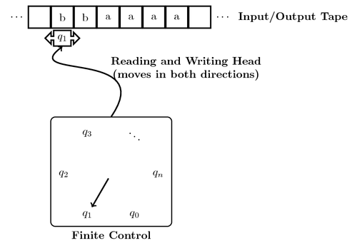
Working principle

Slide 15
Language Hierarchy
Non-Recursively Enumerable Languages
Recursively Enumerable Languages
Recursive Languages
Context-Sensitive Languages
Context-Free Languages - ε
Regular Languages - ε

Slide 16
TYPES OF LANGUAGES-HIERARCHY
Recursively enumerable languages are also known as type 0 languages.
Context-sensitive languages are also known as type 1 languages.
Context-free languages are also known as type 2 languages.
Regular languages are also known as type 3 languages.

Slide 17
Definition: Let L be a language. Then L is recursively enumerable if there exists a TM M such that L = L(M).
If L is r.e. then L = L(M) for some TM M, and
If x is in L then M halts in a final (accepting) state.
If x is not in L then M may halt in a non-final (non-accepting) state or no transition is available, or loop forever.
Definition: Let L be a language. Then L is recursive if there exists a TM M such that L = L(M) and M halts on all inputs.
If L is recursive then L = L(M) for some TM M, and
If x is in L then M halts in a final (accepting) state.
If x is not in L then M halts in a non-final (non-accepting) state or no transition is available (does not go to infinite loop).
Notes:
The set of all recursive languages is a subset of the set of all recursively enumerable languages
Terminology is easy to confuse: A TM is not recursive or recursively enumerable, rather a language is recursive or recursively enumerable.
Notes:
What is rule #10 used for – emptying the stack.
What is rule #9 used for – emptying the stack.
Why do rules #3 and #6 have options – you don’t know where the middle of the string is.
Why don’t rules #4 and #5 have similar options – suppose rule #4 had option (q₂, λ). Then 0100 would be accepted.

Slide 18
L is Recursively enumerable:
TM exist: M₀, M₁, …
They accept string in L, and do not accept any string outside L
L is Recursive:
at least one TM halts on L and on ∑*-L, others may or may not
L is Recursively enumerable but not Recursive:
TM exist: M₀, M₁, …
but none halts on all x in ∑*-L
M₀ goes on infinite loop on a string p in ∑*-L, while M₁ on q in ∑*-L
However, each correct TM accepts each string in L, and none in ∑*-L
L is not R.E:
no TM exists

Slide 19
Techniques for TM Constructions
Techniques
Memory on Finite Control
Sub-routines
Checking Off Symbols
Multi Tracks/ Tapes
Other (Extended) TM Models:
One-way infinite tapes
Multiple tapes and tape heads
Non-Deterministic TMs
Multi-Dimensional TMs (n-dimensional tape)
Multi-Heads

Slide 20
TURING MACHINE ACCEPTANCE
RECURSIVE LANGUAGE
L is a recursive language, if we can construct TM that either accepts a string in the language or rejects a string that is not in the language.
RECURSIVE ENUMERABLE LANGUAGE
L is a recursively enumerable language, if we can construct TM that either accepts or loops infinitely.
yes
w
M
no
yes
w
M
Infinite Loop

Slide 21
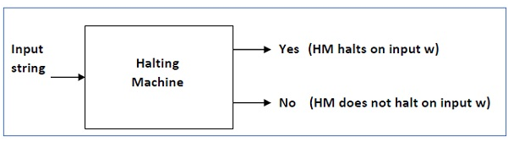
Halting Problem

Slide 22
Example : {0^{n}1^{n} | n ≥ 1}
0 1 X Y B
->q₀ (q₁, X, R) - - (q₃, Y, R)0’s finished -
q₁ (q₁, 0, R)ignore1 (q₂, Y, L) - (q₁, Y, R) ignore2 - (more 0’s)
q₂ (q₂, 0, L) ignore2 - (q₀, X, R) (q₂, Y, L) ignore1 -
q₃ - - (more 1’s) - (q₃, Y, R) ignore (q₄, B, R)
q₄* - - - - -
Sample Computation: (on 0011), presume state q looks rightward
q₀0011BB.. |— Xq₁011
|— X0q₁11
|— Xq₂0Y1
|— q₂X0Y1
|— Xq₀0Y1
|— XXq₁Y1
|— XXYq₁1
|— XXq₂YY
|— Xq₂XYY
|— XXq₀YY
|— XXYq₃Y B…
|— XXYYq₃ BB…
|— XXYYBq₄
Instantaneous Description

Slide 23
Making a TM for {0^{n}1^{n} | n >= 1}
Try n=2 or 3 first.
q0 is on 0, replaces with the character to X, changes state to q1, moves right
q1 sees next 0, ignores (both 0’s and X’s) and keeps moving right
q1 hits a 1, replaces it with Y, state to q2, moves left
q2 sees a Y or 0, ignores, continues left
when q2 sees X, moves right, returns to q0 for looping step 1 through 5
when finished, q0 sees Y (no more 0’s), changes to pre-final state q3
q3 scans over all Y’s to ensure there is no extra 1 at the end (to crash on seeing any 0 or 1)
when q3 sees B, all 0’s matched 1’s, done, changes to final state q4
blank line for final state q4
Try n=1 next.
Make sure unbalanced 0’s and 1’s, or mixture of 0-1’s,
“crashes” in a state not q4, as it should be
q₀0011BB.. |— Xq₁011
|— X0q₁11
|— Xq₂0Y1
|— q₂X0Y1
|— Xq₀0Y1
|— XXq₁Y1
|— XXYq₁1
|— XXq₂YY
|— Xq₂XYY
|— XXq₀YY
|— XXYq₃Y B…
|— XXYYq₃ BB…
|— XXYYBq₄

Slide 24
Example
C = {a^{i}b^{j}c^{k} | k = i×j, and i, j, k ≥ 1}
aaabbbbcccccccccccc
3
4
3×4 = 12
Notes:
(If not much time left, skip this.)
We can have a TM that does some basic arithmetic.
If we run out of c’s in stage 3, we’ll reject in that case too.
24

Slide 25
C = {a^{i}b^{j}c^{k} | k = i×j, and i, j, k ≥ 1}
LOGIC
For each occurrence of a: {
For each occurrence of b: {
Delete an occurrence of c.
}
}
Notes:
(If not much time left, skip this.)
We can have a TM that does some basic arithmetic.
If we run out of c’s in stage 3, we’ll reject in that case too.
25

Slide 26
C = {a^{i}b^{j}c^{k} | k = i×j, and i, j, k ≥ 1}
If the input doesn’t match a*b*c*, reject.
Move the head back to the leftmost symbol.
Cross off an a, scan to the right until b. Sweep between b’s and c’s, crossing out one of each until all b’s are out. If too few c’s, reject.
Uncross all the b’s. If there’s another a left, then repeat stage 3. If all a’s are crossed out, Check if all c’s are crossed off. If yes, then accept, else reject.
Notes:
(If not much time left, skip this.)
We can have a TM that does some basic arithmetic.
If we run out of c’s in stage 3, we’ll reject in that case too.
26

Slide 27
C = {a^{i}b^{j}c^{k} | k = i×j, and i, j, k ≥ 1}
aabbbcccccc
xabbbcccccc
xayyyzzzccc
xabbbzzzccc
xxyyyzzzzzz
Notes:
Here’s an example.
27

Slide 28
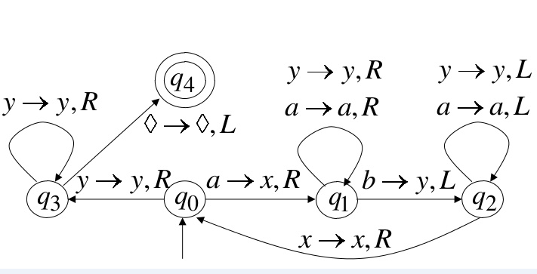
Example : a^n b^n

